Slide 1
OrderPlace Buyer’s Guide

Slide 2
OrderPlace User Guide Contents
Buyer’s Home Page
Product List Page
Product Detail Page
Product Configurator Page
Shopping Cart
Confirmation Email

Slide 3
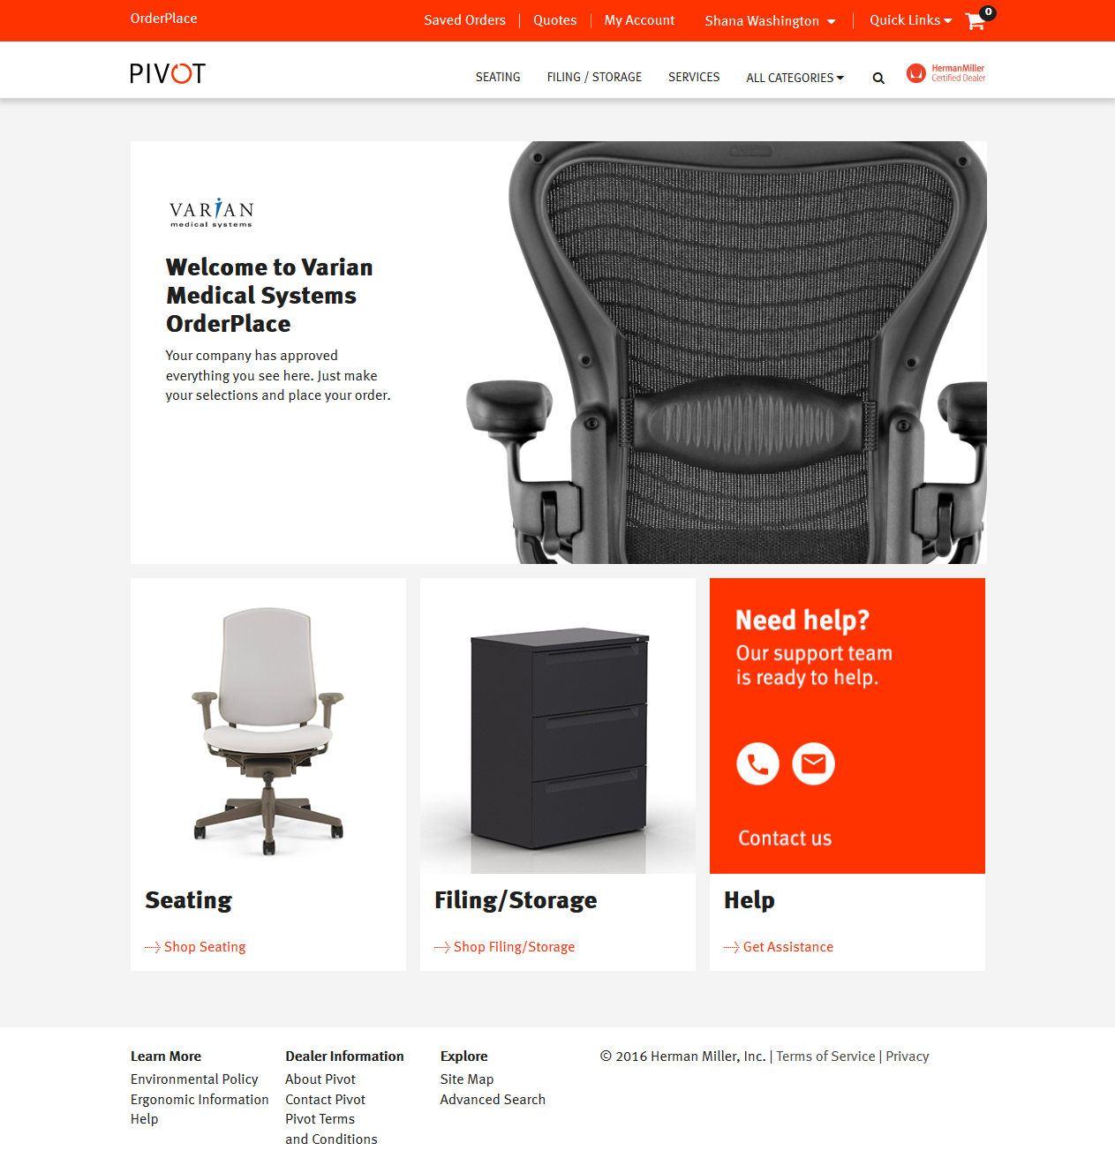
Buyer’s Home Page
Saved orders and account information are a click away.
Select a product category.
Search features and helpful links make finding information easy.
Return to Contents Slide

Slide 4
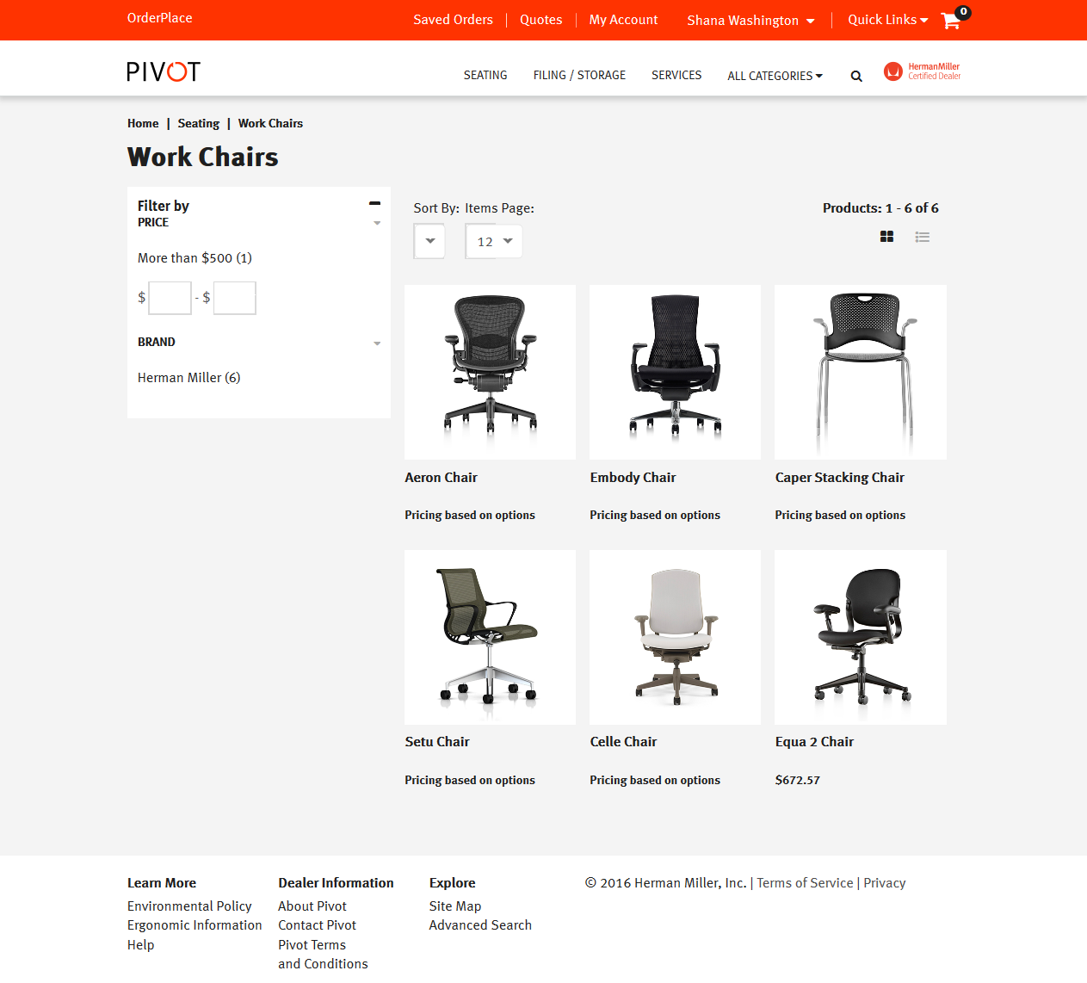
Product List Page – Catalog Orders
Sorting organizes products by preference (sort order and number of items per page).
Buyers can select preapproved product lines.
Return to Contents Slide

Slide 5
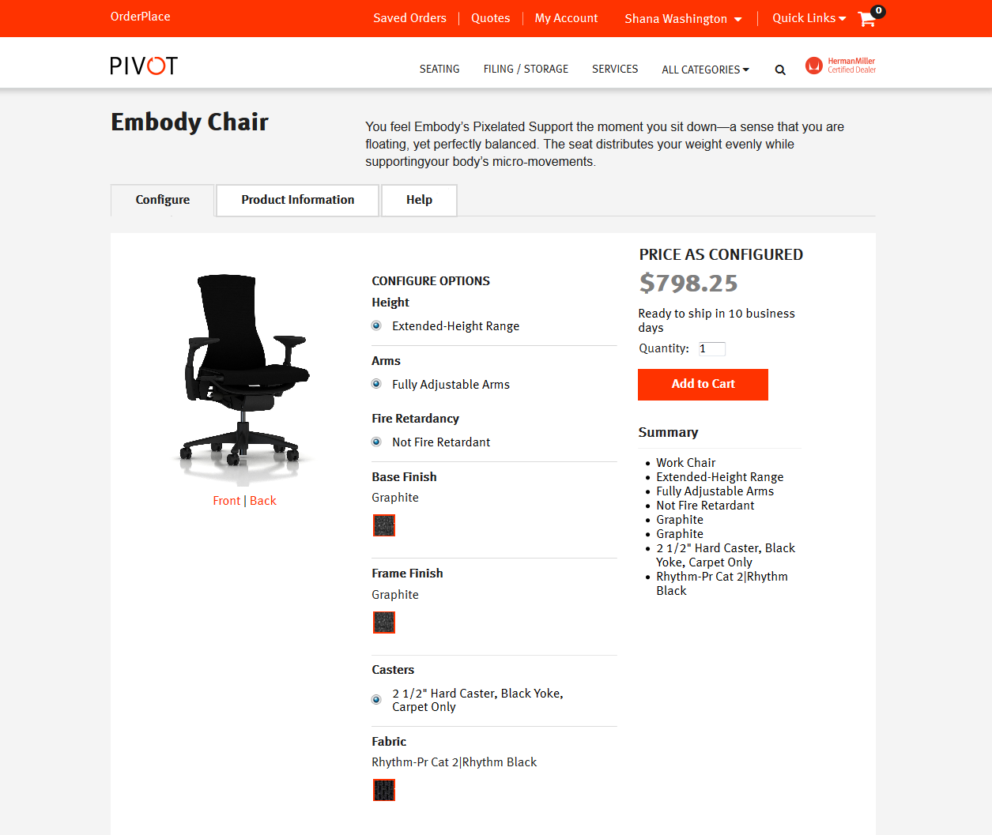
Product Detail Page
Buyers can use the Product Configurator.
Product Information is easily available.
Help provides assistance when needed.
Return to Contents Slide

Slide 6
Product Configurator Page
The Product Configurator enables buyers to view configured product images.
Select pre-specified options.
Add quantity.
Review contract pricing.
Return to Contents Slide

Slide 7
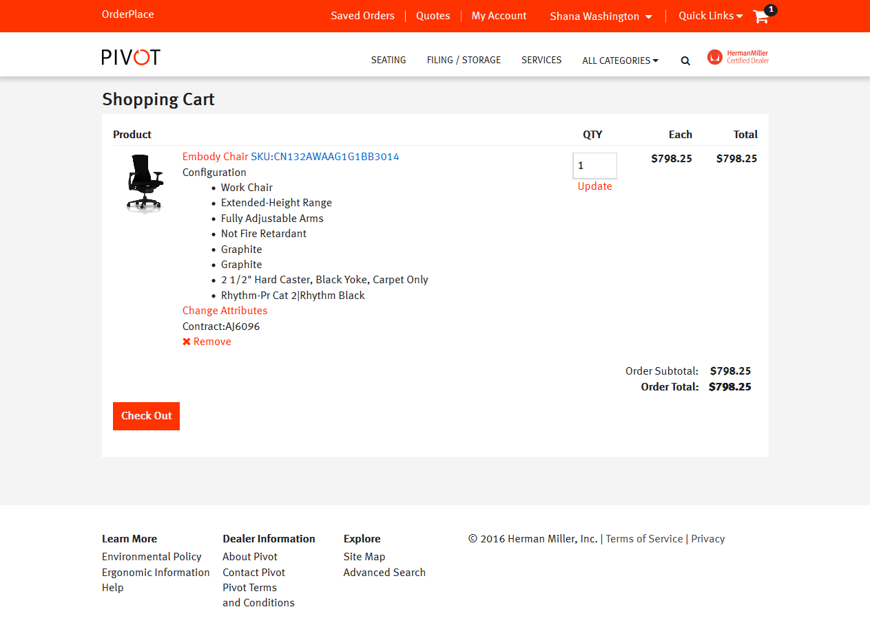
Shopping Cart
Buyers can review product(s) in the Shopping Cart.
Changes can be made.
After reviewing, the buyer clicks Check Out or Return to eProcurement system.
Return to Contents Slide

Slide 8
Confirmation Email
Buyer receives a confirmation email with details of the order.
Order goes through requisition and approval process in eProcurement System.
Electronic PO is sent to Pigott for processing.
Return to Contents Slide

Slide 9
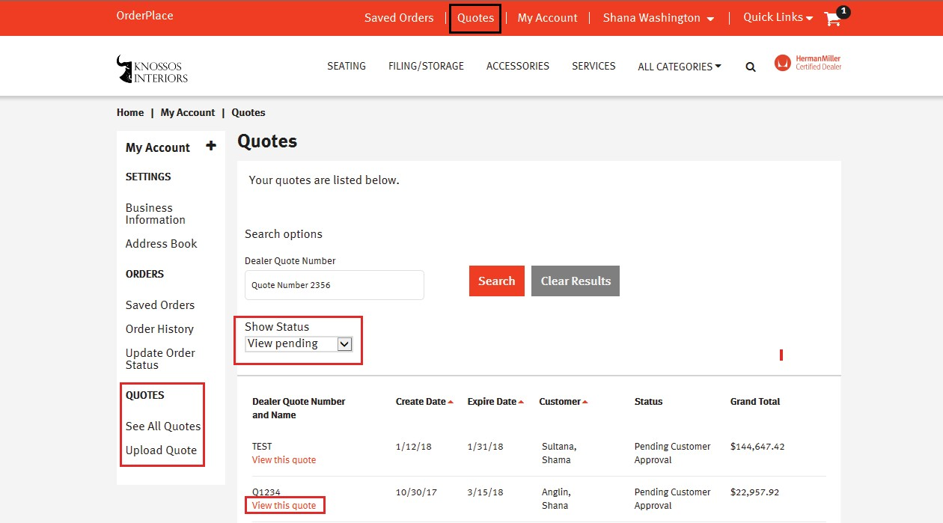
Quoting Tools
ORDERPLACE
Your Dealer sales team can upload a quote to the catalog for you. First, if you have never accessed the catalog please do so in order for your credentials to be available to your Dealer. OrderPlace will notify you when the quote is available; simply punchout to the catalog and pull your quote into a shopping cart.
Notes:
Review quoting capabilities and catalog orders.

Slide 10
If you encounter any issues processing and placing your order, please contact OrderPlace Support Team at (877) 772-5555 (7am-5 pm EST M-F), or OrderPlace Support at OrderPlace@hermanmiller.com.
Or call:
1-877-772-5555

