Slide 1

Sole Source Training

Slide 2
WHAT IS A SOLE SOURCE?
A sole source means the item/service is unique and that the Vendor is the sole provider (in the world) from whom the item/service can be obtained.
Good Example: Swedish High-Speed Equine Treadmill
Bad Example: Recreational Equipment
The Sole Source Certification form is available on the Procurement Services website: https://procurement.ufl.edu/uf-departments/
Notes:
A true Sole Source is a purchase greater than $75,000 and there is only one vendor in the world that can provide that product and/or service.
Along with the sole source form

Slide 3

SOLE SOURCE REQUIREMENTS
MUST INCLUDE:
Vendor Quote
Reasonable price justification: i.e. historical pricing, cost analysis, or comparable price
A thorough explanation written in layman’s terms – what is unique and how it is relevant to the work being done
MUST BE:
Completed and signed by the Professor/PI
Publicly posted and open to protest for 72 hours
Notes:
The explanation must be clearly written in laymen’s term –what is unique and how does it relate to work being done. Can not be written by the sales rep.
-Signed by the user of the product or service. They are certifying that the statements are true.
-Must be posted for 72 hours on Purchasing’s website.
Let’s now talk purchasing methods

Slide 4
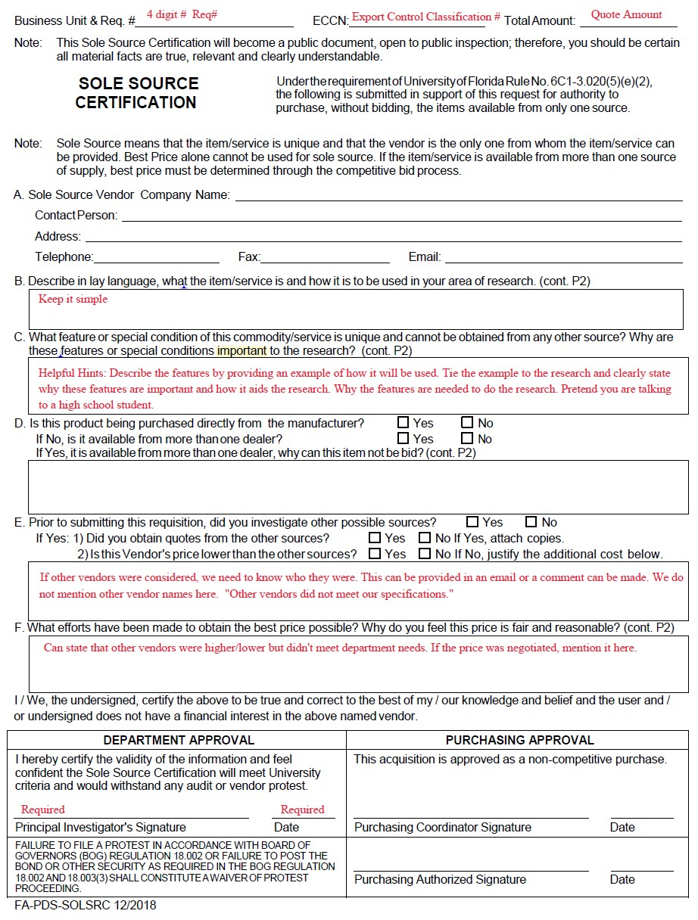

Slide 5
QUESTIONS

