Slide 1

Managing Receipts with ExpenseIt
February 15, 2024

Slide 2

Agenda
ExpenseIt
What Changed?
Payment Types
Accessing Existing Receipts
Uploading New Receipts
Demo
Questions
UF GO Managing Receipts with ExpenseIt

Slide 3
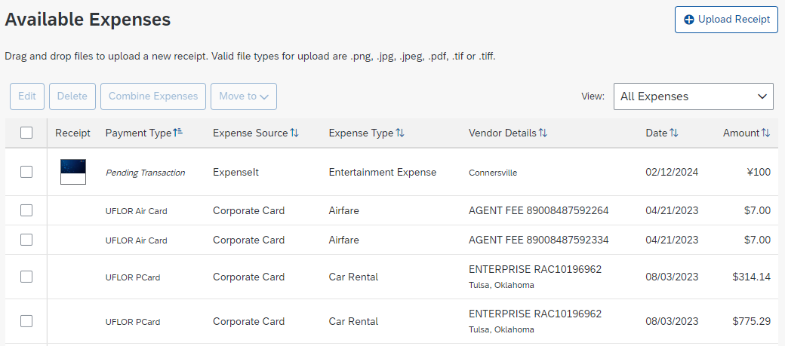
What is ExpenseIt?
Value-added service integrated with UF GO system
Turns receipts into expense line items using artificial intelligence (AI) including optical character recognition (OCR) and machine learning (ML)
UF GO Managing Receipts with ExpenseIt​

Slide 4
Benefits of ExpenseIt
Streamlined functionality for users
  Automatically creates expense lines
  Matches receipts with credit card charges
Leverages AI
  Uses AI (OCR, ML, user history, etc.) to read receipts and categorize and itemize expenses
Smart Predictions
  Using machine learning, predicts the payment type & expense type
UF GO Managing Receipts with ExpenseIt​

Slide 5

Benefits of ExpenseIt
Simply put...
  Reduces administrative time/burden
  Reduces data entry errors
UF GO Managing Receipts with ExpenseIt​

Slide 6

What Changed?
ExpenseIt creates expense entries for receipts:
Prior State | Current State
Uploaded through mobile app Emailed to receipts@expenseit.com | Uploaded through mobile app Emailed to receipts@expenseit.com Uploaded via web at concursolutions.com
ExpenseIt now reviews all receipts.
UF GO Managing Receipts with ExpenseIt​

Slide 7
What does that mean for you?
Available Receipts section is gone
All receipts are now creating an expense line under Available Expenses
  Payment Type: Pending Transaction
  Expense Source: ExpenseIt
UF GO Managing Receipts with ExpenseIt​

Slide 8
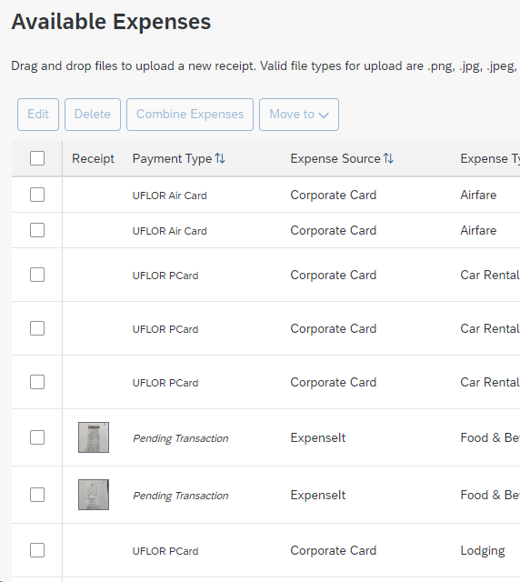
Payment Types
There are 4 Payment Types:
  UFLOR Air Card
  UFLOR PCard
  Pending Transaction
  Personal Funds
UF GO Managing Receipts with ExpenseIt​

Slide 9
Payment TypeS
Air Card + PCard Transactions | Pending Transactions
Are imported from the bank Can be combined with a Pending Transaction Can be moved to a new or existing report Have fixed details that cannot be edited (date, amount, vendor, etc.) Cannot be changed to a different payment type | Are uploaded via mobile app, email, or web Can be combined with an Air Card or PCard transaction* Can be moved to a new or existing report Can be edited to match the expense/receipt Can be changed to a Personal Funds payment type* Can be deleted
UF GO Managing Receipts with ExpenseIt​

Slide 10
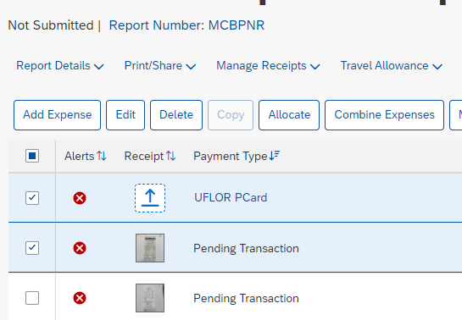
Pending Transactions
*A report cannot be submitted with a Pending Transaction.
Pending Transactions must either be...
  combined with an actual card charge,
  changed to Personal Funds, or
  deleted
UF GO Managing Receipts with ExpenseIt​

Slide 11
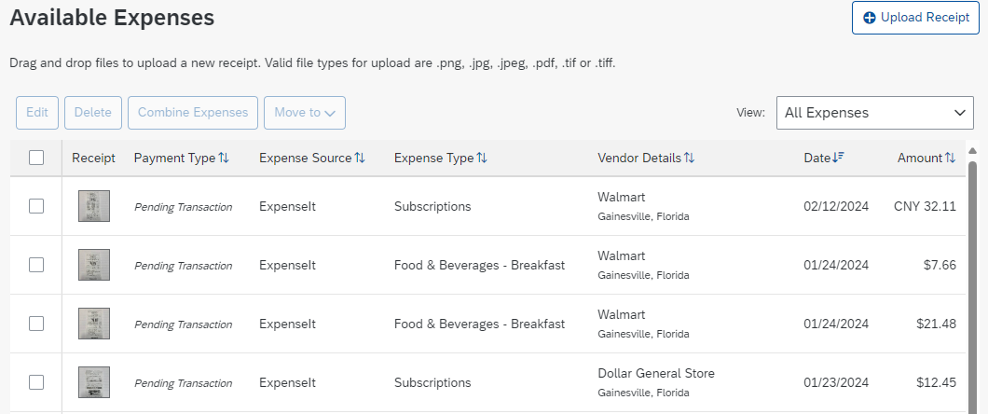
Pending transactions
Always review Pending Transactions for accuracy.
Remember to review:
  Expense Type
  Vendor Details
  Date
  Amount
ExpenseIt's AI should learn and improve over time, but the user is responsible for ensuring the data is correct.
UF GO Managing Receipts with ExpenseIt​
Notes:
Machine Learning might not be perfect right now.
Please review your expense reports for errors:
Amount matches receipt
Expense Type is correct
Itemizations are correct
Correcting mistakes will “teach” Expense It the type of transactions we make and will learn to match certain receipts to the expense type, the more it comes in contact with the receipts (and corrections are made) the more accurate this feature will become. If we “teach” it wrong, then it will not be as accurate.

Slide 12

Air Card & Pcard transactions
Card transactions can
NOT be deleted.
UF GO Managing Receipts with ExpenseIt​

Slide 13
Existing Receipts
Receipts uploaded prior to the rollout of ExpenseIt for web (concursolutions.com) can be found in the receipt panel within expense reports
UF GO Managing Receipts with ExpenseIt​

Slide 14
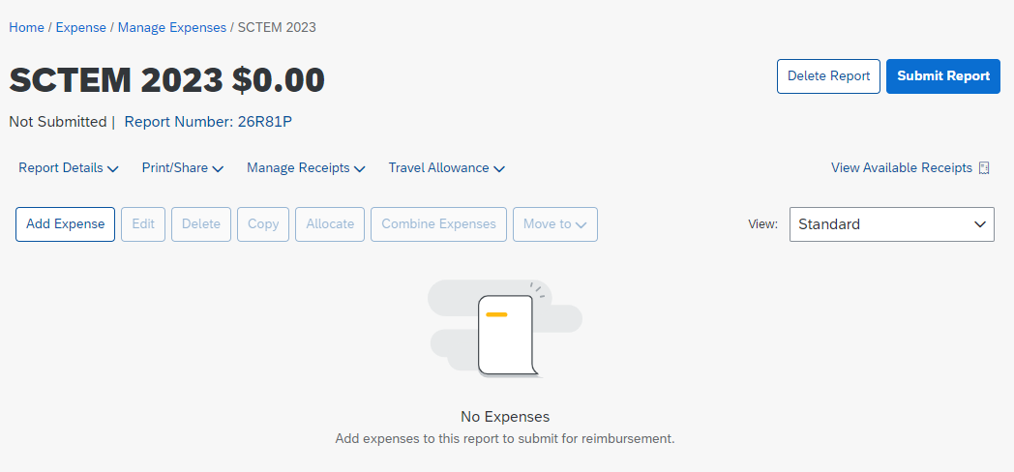
Existing Receipts
Receipts uploaded prior to the rollout of ExpenseIt for web (concursolutions.com) can be found in the receipt panel within expense reports
UF GO Managing Receipts with ExpenseIt​

Slide 15
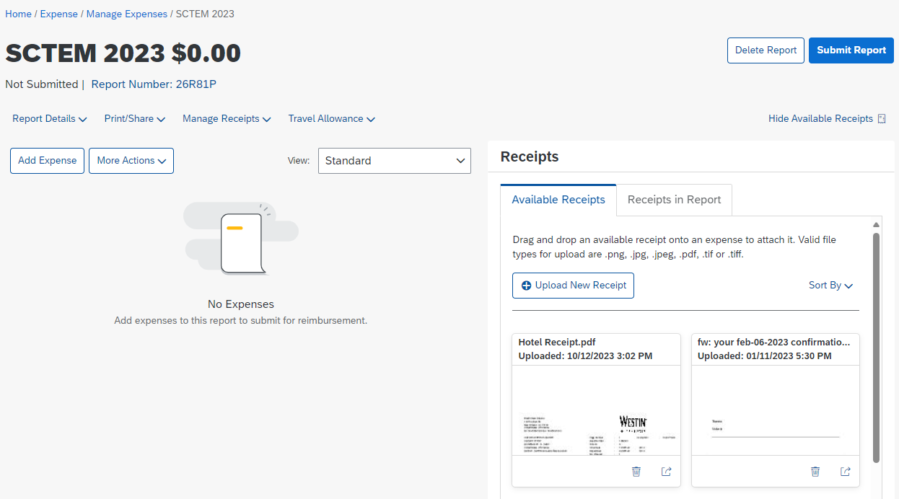
Existing Receipts
Receipts uploaded prior to the rollout of ExpenseIt for web (concursolutions.com) can be found in the receipt panel within expense reports
UF GO Managing Receipts with ExpenseIt​

Slide 16
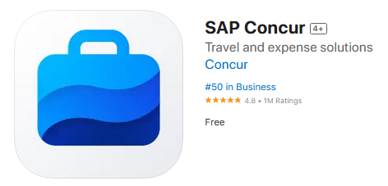
Upload New receipts
SAP/ Concur
Mobile App
Via the mobile app
Email to receipts@expenseit.com (Toolkit)
Upload from the Expense module (concursolutions.com)
Upload within an Expense Report through:
  Report Level Attachment
  Available Receipts
  Individual expense line
UF GO Managing Receipts with ExpenseIt​

Slide 17
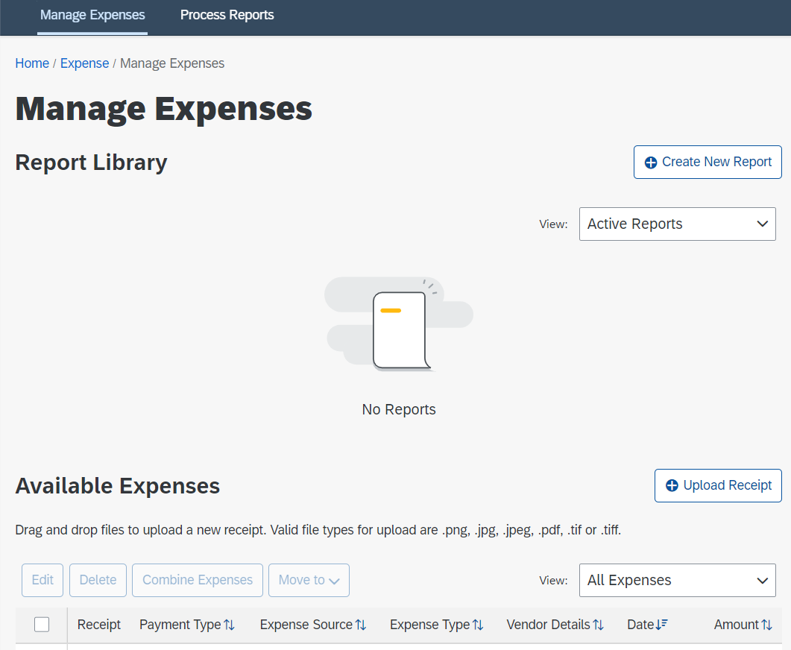
Upload New receipts: Expense Module
Upload in the Expense module
  > Expense
  > Manage Expenses
  > Available Expenses
UF GO Managing Receipts with ExpenseIt​

Slide 18
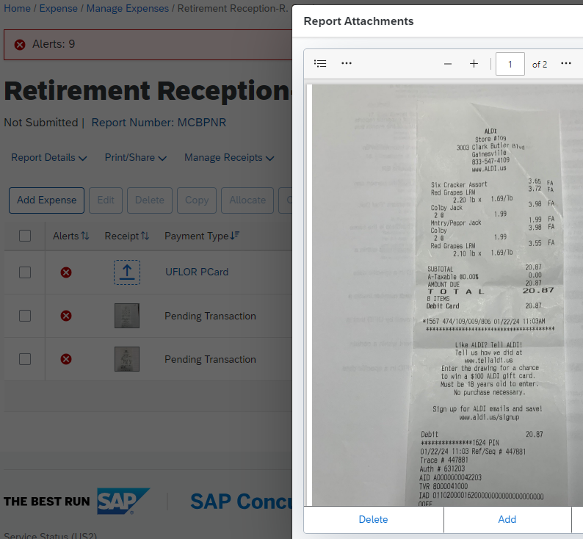
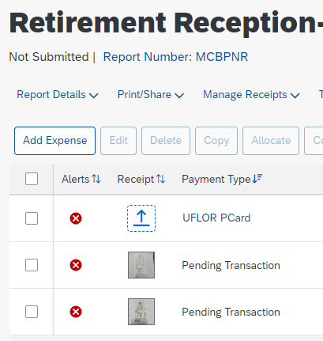
Upload New receipts: expense Report
Upload within an Expense Report:
  Report Level Attachment
UF GO Managing Receipts with ExpenseIt​

Slide 19
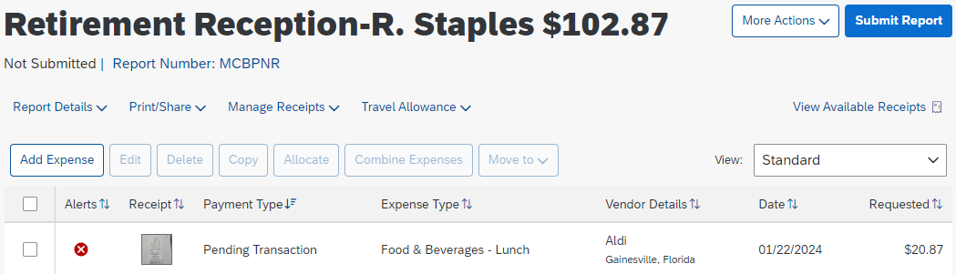
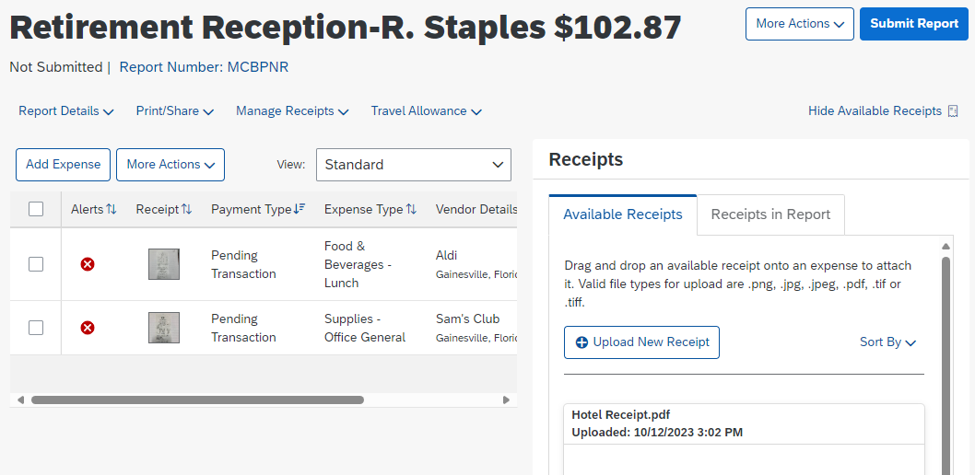
Upload New receipts: expense Report
Upload within an Expense Report:
  Available Receipts
UF GO Managing Receipts with ExpenseIt​

Slide 20
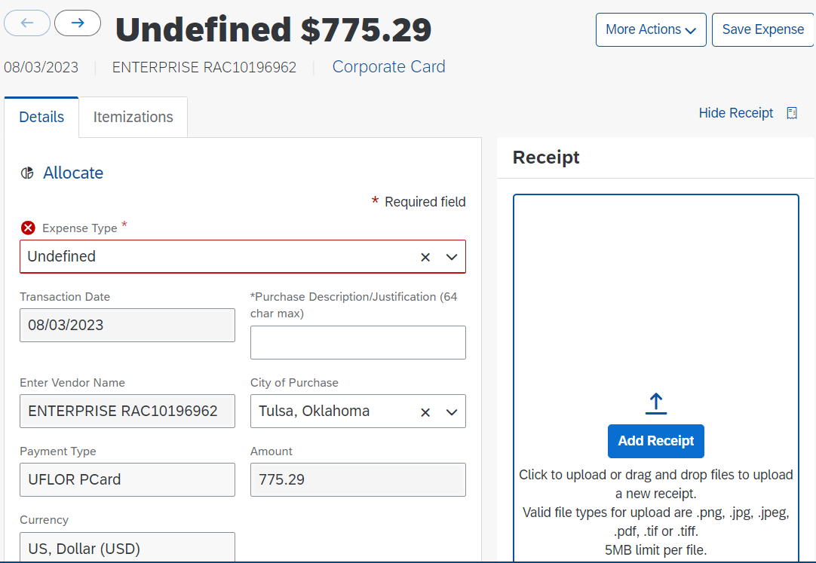
Upload New receipts: expense Report
Upload within an Expense Report:
  Individual expense line
UF GO Managing Receipts with ExpenseIt​

Slide 21
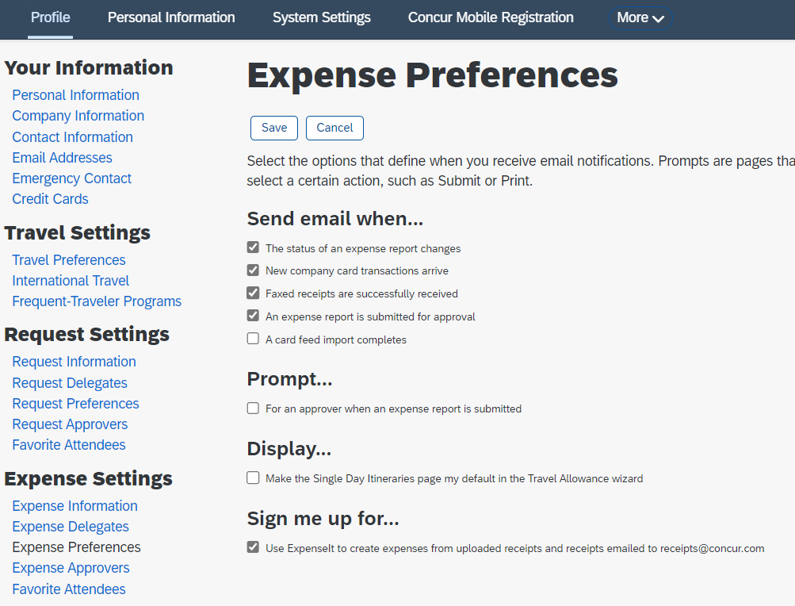
Don’t like expenseit?
Users can opt out of the ExpenseIt feature
Navigation:
  Profile Settings
  Expense Preferences
  Under "Sign me up for...", uncheck the "Use ExpenseIt..." Option.
The system will revert to the old receipt upload method and the Available Receipts section will return
UF GO Managing Receipts with ExpenseIt​

Slide 22

No expenseit, No streamlining
The ExpenseIT AI cannot learn and improve if the feature is turned off.
UF GO Managing Receipts with ExpenseIt​

Slide 23

Demo

Slide 24
Questions?

Slide 25
Contact Form: PCard and Travel Support
We are happy to help!
CONTACT US!
UF Travel Department: 352-392-1241
UF PCard Team: 352-392-1331

